Slide 1
BA Practicum Netflix
YU-MIN WANG
Aug. 04, 2017

Slide 2
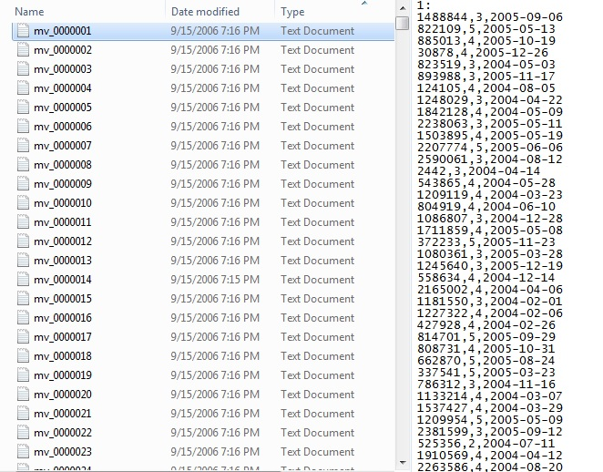
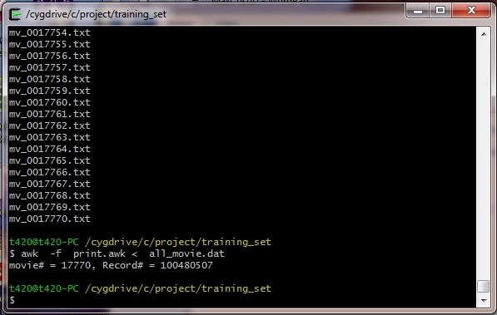
Data Format
Use AWK to aggregate 17770 files into one

Slide 3
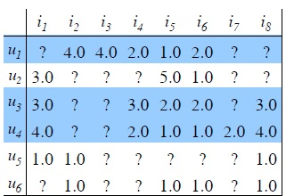
How many users do we have?
480189 active users
with max Cust ID 2649429
R ran out of 16GB RAM when storing the matrix of 480189 x 17770 = 8.5 billion fields

Slide 4
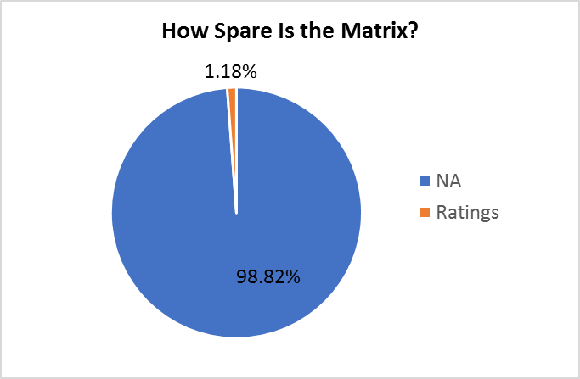
Use sparseMatrix
Only 1.18% of fields have values, the rest are NAs
sparseMatrix will not waste memory to store NAs
The resulting matrix is 1.3GB

Slide 5
Sparsematrix creates 2649429 rows rather than 480189 rows
> library(“Matrix”) > N<- sparseMatrix(i=mvTrain[[2]], j=mvTrain[[1]],x=mvTrain[[3]]) > nrow(N)
[1] 2649429 > dimnames(N) <- list(user=as.character(c(1: nrow(N))), movie=as.character(c(1:ncol(N))))
> library("recommenderlab")
> r<-as(N,"realRatingMatrix")
> r<-r[rowCounts(r)>0]
> nrow(r)
[1] 480189
Number of rows of sparseMatrix = the max. CustID (2649429), not the number of active users (480189)
It doesn’t bother because inactive users occupy zero space
Give row names to keep indexing if we want to delete inactive users

Slide 6
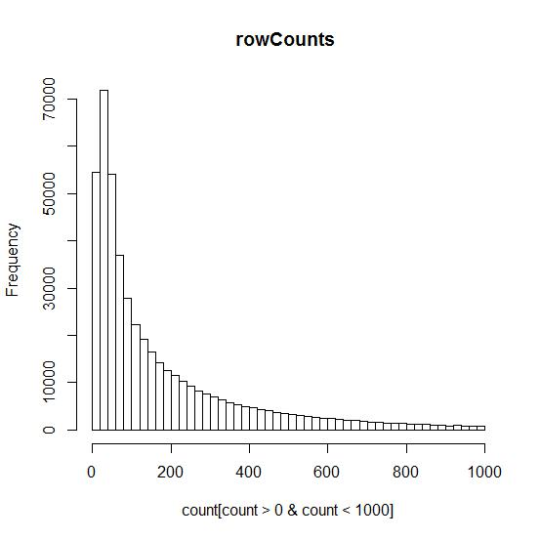
Most Users rate only 21~40 movies
This chart represents 97.6% of active users

Slide 7
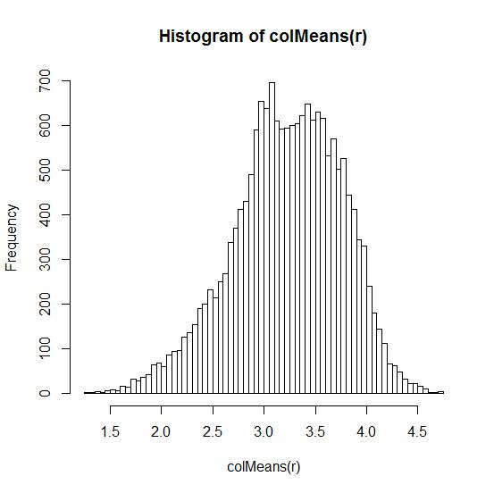
The mode of avg movie rating is 3.0~3.05
Median = 3.25
Mean = 3.23
Pretty close to normal dist., but a little left-skewed
Min. 1st Qu. Median Mean 3rd Qu. Max.
1.288 2.897 3.255 3.228 3.616 4.723

Slide 8
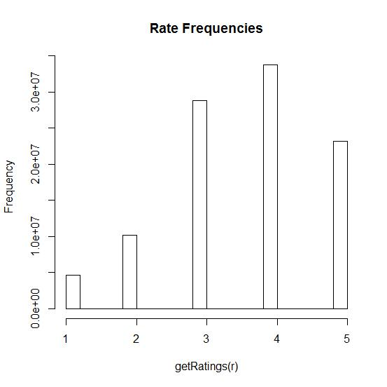
Rate “4” happens most often
Of the 100 million ratings, rate “4” happens about 35 million times

Slide 9
Implementation procedure
AWK in Cygwin
Matrix package in R
SparseMatrix in R
To aggregate all 17770 files into a pool file
Reshape the file
Store the huge matrix without exhausting RAM
EvaluationScheme in R
grepl(), gsub(), append() in R
Recommenderlab package in R
Calculate RMSE
Import Probe in 3 times
Give top 5 movie recommendations

Slide 10
Challenges & solutions
 | CHALLENGES | SOLUTIONS
1 | How to aggregate the 17770 files into a file in the format that R can import ? | Install Cygwin, run UNIX command, write a AWK script file as the input to UNIX command
2 | How to reshape the aggregate file format from the original 4 columns by 100 million observations to a matrix with userID as rows and movieID as columns? | Two ways : one is to use library “reshape2” and function acast() to do reshape, but this method will overload RAM. The other way is to create a sparseMatrix
3 | How to store such a huge matrix with 480189 rows of active users by 17770 columns of movies without exhausting RAM space? | Use library “Matrix” and function sparseMatrix() which will not physically store NA values
4 | The maximum userID of the active users is 2649429 while the number of active users is 480189. Can we build only the active users in the rows while we can still trace the userID? | With sparseMatrix(), the used memory size of 2649429 rows is the same as 480189 rows because no-rating users occupy zero space. Use the dimnames() function to assign user IDs for rownames then we can trace the userID.

Slide 11
Challenges & solutions
 | CHALLENGES | SOLUTIONS
5 | How to make the memory usage as efficiently as possible? | Remove some useless matrix by rm(), and use gc() to do garbage collection. The following functions help know the usage of memory : memory.limit(), memory.size(), object.size()
6 | How to import probe file? | Divide the 1.4 million lines into 3 parts, and import the 3 parts separately in R, then append the 3 parts into a full vector
7 | How to make a top 5 movie recommendations to each active user? | Use library “recommenderlab”, transform the matrix to realRatingMatrix, do function Recommender(), then use predict by indicating the user ID and topN =5
8 | How to predict ratings and evaluate RMSE of each method? | Use function evaluationScheme(), then predict, then calcPredictionAccuracy() to calculate the RMSE

Slide 12
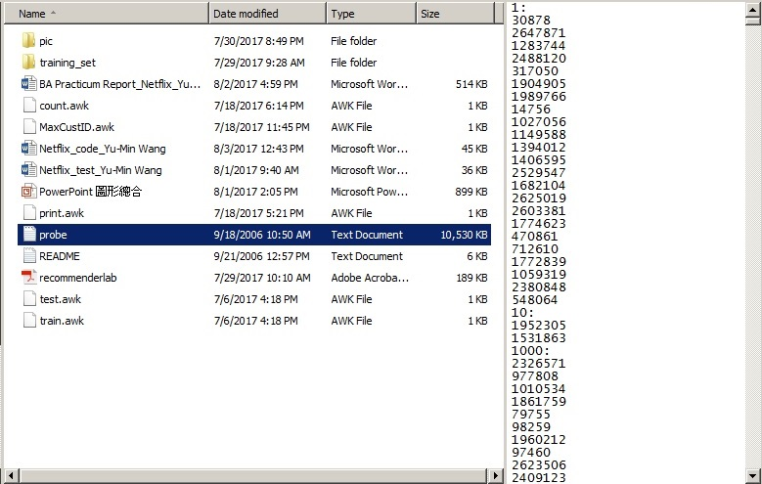
Import probe
One text file “probe.txt”
10MB
Different format
movieIDs with “:”
Followed by userID
Can not use AWK
Use R string comparison and replacement functions

Slide 13
Movie Recommendations
We can give topN recommendations to a certain user
> library(“recommenderlab”)
> recP <- Recommender(r, method="POPULAR")
> recomP <- predict(recP, r["7"], n=5)
> as(recomP, "list")
$`7`
[1] "14621" "6974" "14103" "7193" "11812"

Slide 14
Rating prediction
This gives rating prediction of userID=6 on movieID=10
> predP <-predict(recP, t["6"], type="ratings")
> as(predP, "matrix")[,10]
[1] 3.301309

Slide 15
Method comparison
method = Popular
method = UBCF
> r1 <- Recommender(getData(e, "train"), "POPULAR")
> p1 <- predict(r1, getData(e, "known"), type="ratings")
> error1 <- calcPredictionAccuracy(p1, getData(e, "unknown"))
> error1
RMSE MSE MAE
0.8741432 0.7641263 0.6914844
> r2 <- Recommender(getData(e, "train"), "UBCF")
> p2 <- predict(r2, getData(e, "known"), type="ratings")
> error2 <- calcPredictionAccuracy(p2, getData(e, "unknown"))
> error2
RMSE MSE MAE
0.8602512 0.7400322 0.6720614
e <- evaluationScheme(r[rowCounts(r)>1000,], method="split", train=0.95,k=1, given=-1)

Slide 16
Lesson learned
library("reshape2")
g<-acast(mvTrain, CustID ~ mvID, value.var="Rate")
##Error: cannot allocate vector of size 63.6 Gb
library("Matrix")
N <- sparseMatrix(i=mvTrain[[2]],j=mvTrain[[1]],x=mvTrain[[3]])
dimnames(N) <- list(user=as.character(c(1: nrow(N))), movie=as.character(c(1:ncol(N))))

Slide 17
Lesson learned
dat = readLines("probe.txt") mID<- 1
mvID<-c()
CustID<-c()
for (str in dat) if(grepl(":",str)) {mID= as.numeric(gsub("\\:", "", str))} else {mvID<-append(mvID, mID); CustID <- append(CustID, as.numeric(str))}
## This command ran overnight and still can not finish
for (str in dat[1:499999]) if(grepl(":",str)) {mID= as.numeric(gsub("\\:", "", str))} else {mvID1<-append(mvID1, mID); CustID1 <- append(CustID1, as.numeric(str))}

